Slide 1
Predicting Song Popularity

Slide 2
Overview
Hypothesis
Data Source
Feature Selection
Variable Histograms and Outliers

Slide 3

Hypothesis
I am curious how to predict song popularity on Spotify. I get really into music, but only on select songs. I am very picky on what I like, but it’s always a supply-side struggle to find enough good songs that I like. It seems like there is an endless amount of artists and new songs, but songs that I personally like has always remained a low, steady ratio of all songs created.
In this study, I will determine if I can better identify how popular a song will be on Spotify by using multivariate regression modeling, EDA, and visualizations.

Slide 4
Data Source
The data source has ultimately come from Spotify’s API, but the specific sampling of data from that API comes from Kaggle, a website that provides datasources specifically for open source, public data science usage.

Slide 5
Feature selection
- Danceability – How suitable a track is for dancing (0.0 – 1.0).
- Energy – Intensity and activity level of a song (0.0 – 1.0).
- Loudness – Overall loudness in decibels (dB).
- Speechiness – Presence of spoken words in the track (0.0 – 1.0).
- Acousticness – Probability that a track is acoustic (0.0 – 1.0).
- Liveness – Probability of a live audience (0.0 – 1.0).
- Valence – Musical positivity or happiness (0.0 – 1.0).
- Tempo – Beats per minute (BPM) of the track.
- Key– Musical key (major/minor).

Slide 6
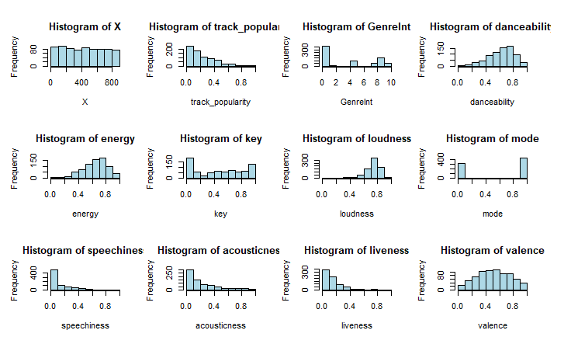
Variable histograms

Slide 7
Variable outliers
For the most part, this dataset is relatively clean and does not contain significant outliers. However, listen before I go by Billie Eilish has a 0 for energy, but there are other tracks in the dataset that have a slower rhythm. I believe this to be a data error, and I will therefore be interpolating a value for this field. rnp (feat. anderson .paak) by Ybncordae has 0.99999999 for speechiness, and will also be interpolated. The next highest value is .59, so I believe this is a data error.
Other than those small outliers, the dataset is very clean as it comes from Spotify’s API.

Slide 8
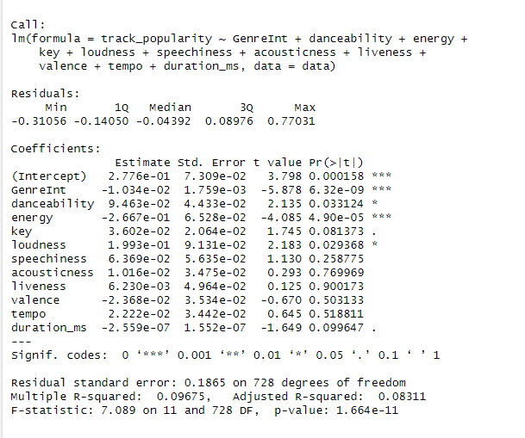
First Model Outcome

Slide 9
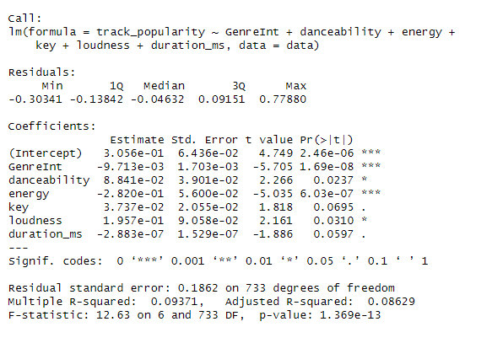
Multivariate model after step-wise feature selection

Slide 10
Summary
Unfortunately, predicting popularity of songs is extremely difficult, and requires a huge amount of data from a variety of sources. Cultural movements and changes, marketing, artists, producers, content of songs, etc are all required to be accurate. I believe accurately predicting popularity would require multiple models acting in unison, from classification models to regression models in order to produce the best outcome.

Slide 11
THANK YOU
Champlin Smith
champsmith@my365.bellevue.edu

